Slide 1
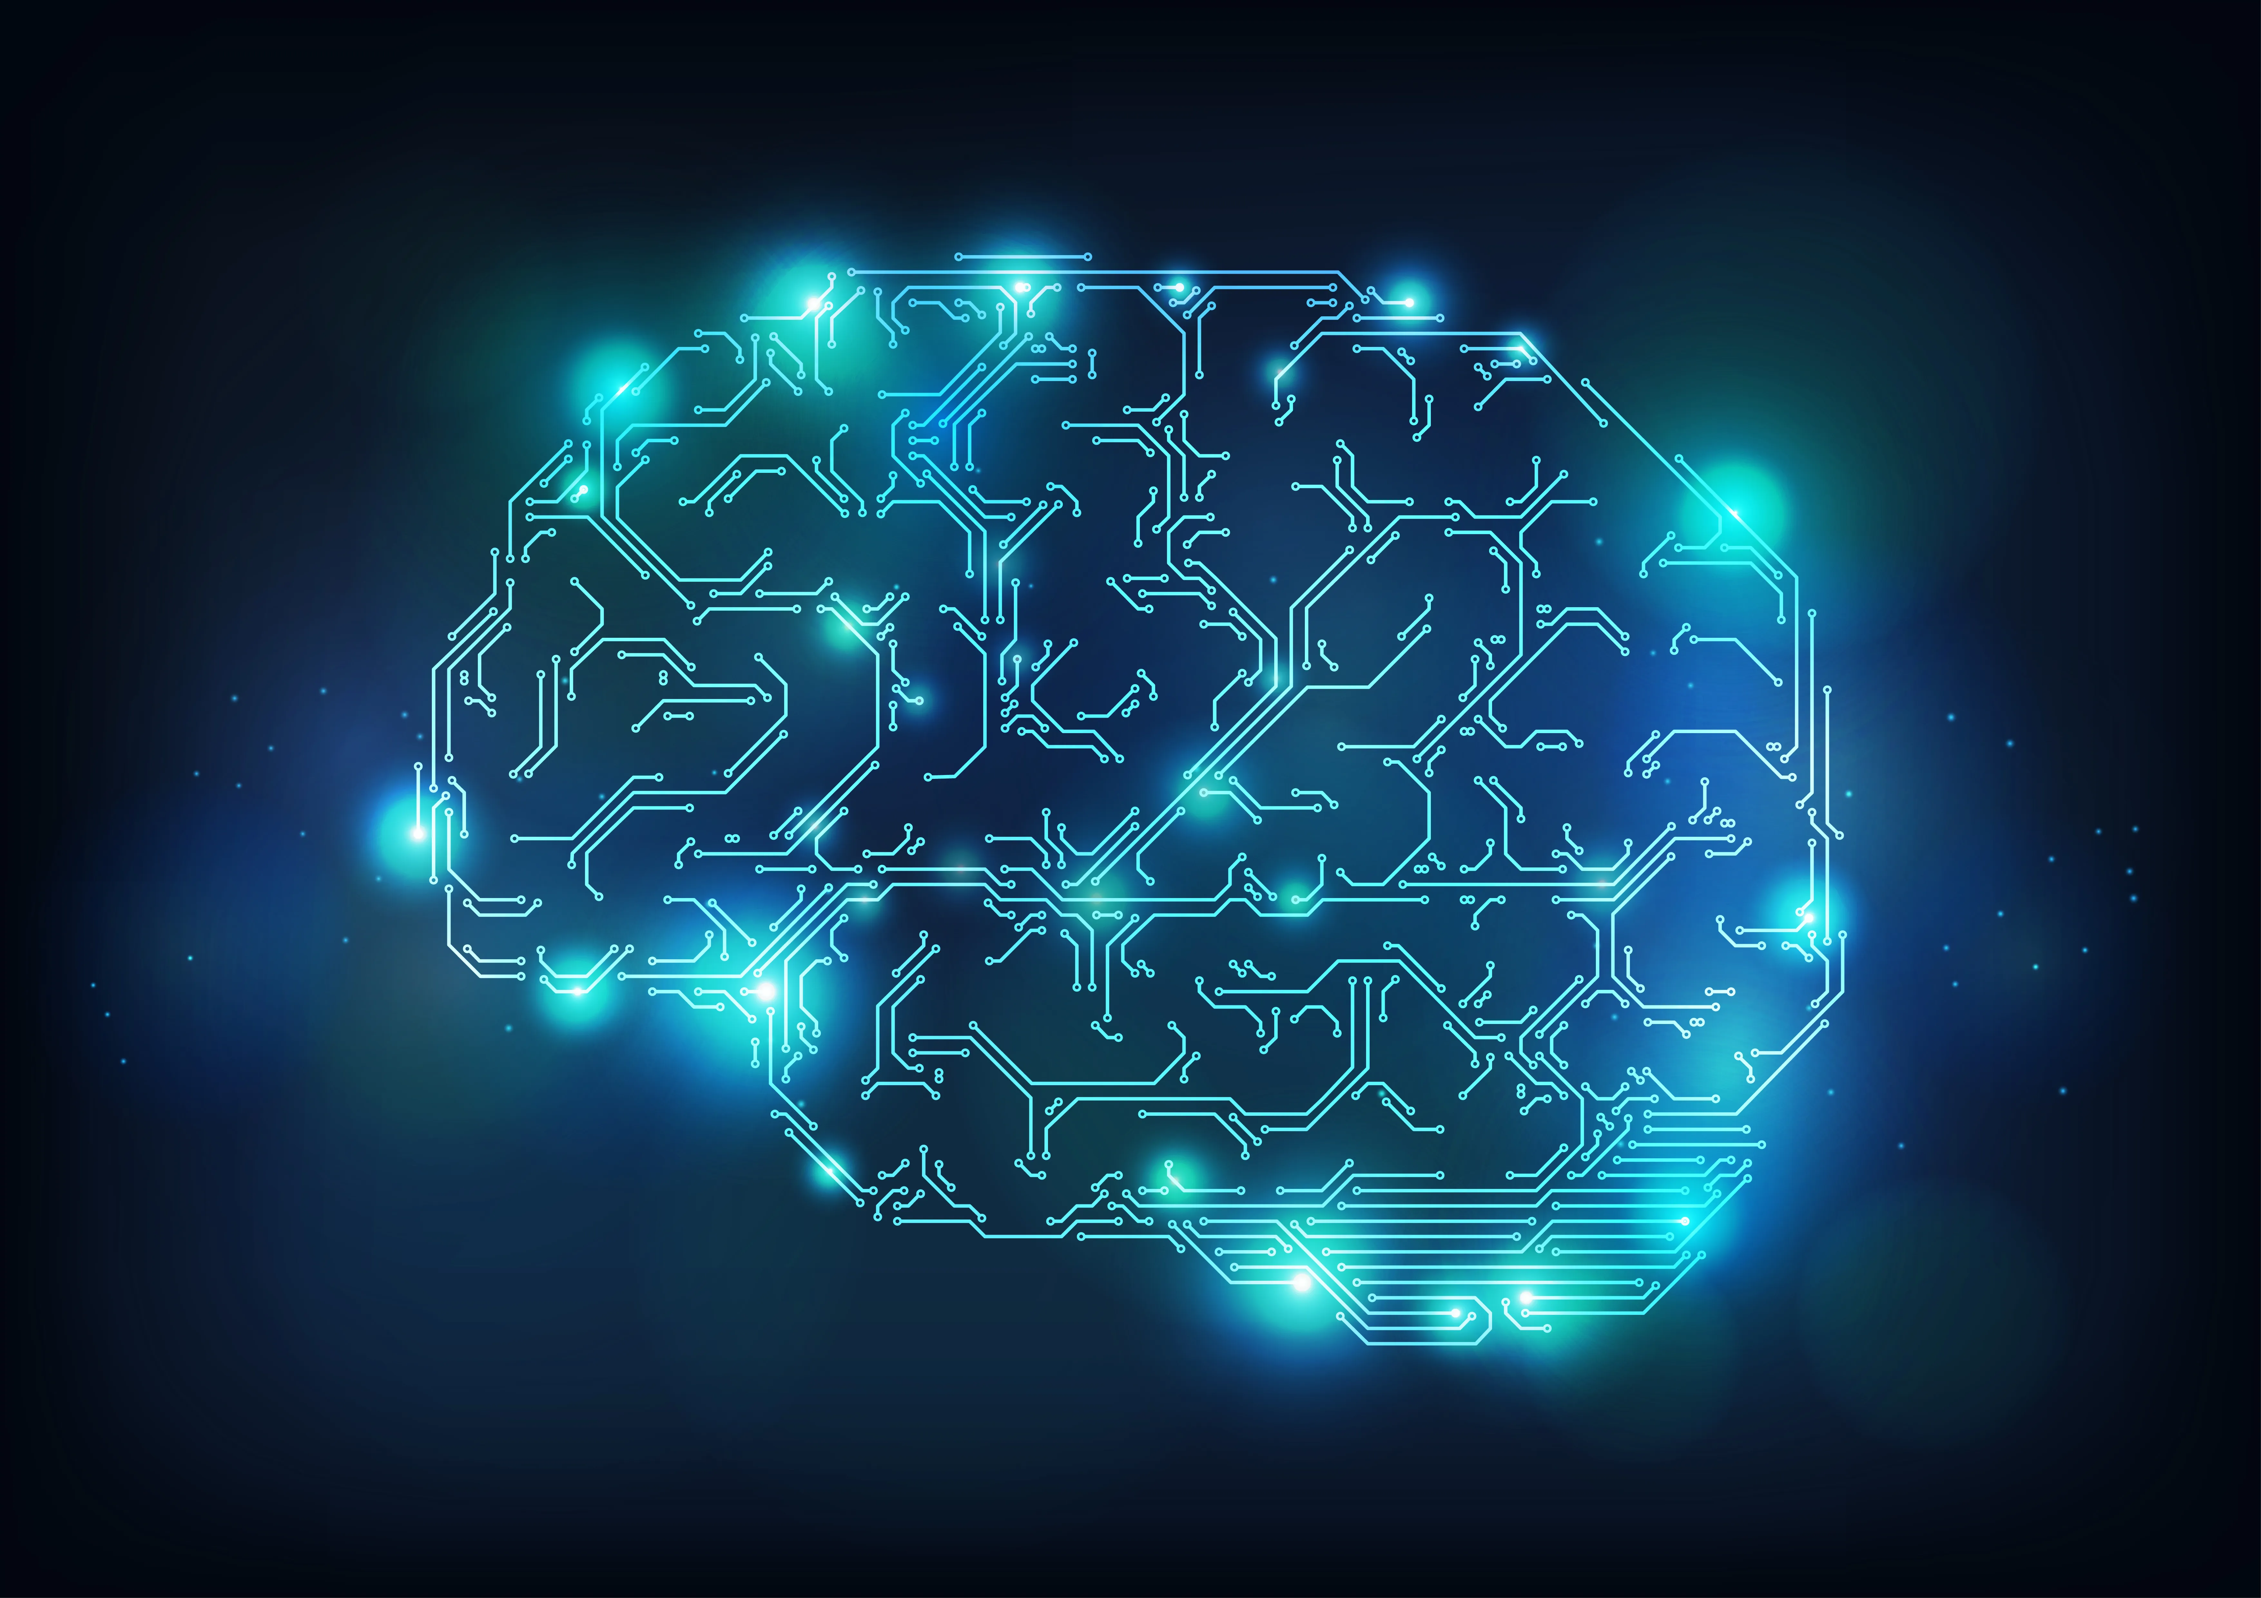
Next-Gen Home Security Framework with Facial Recognition and IoT Integration

Slide 2
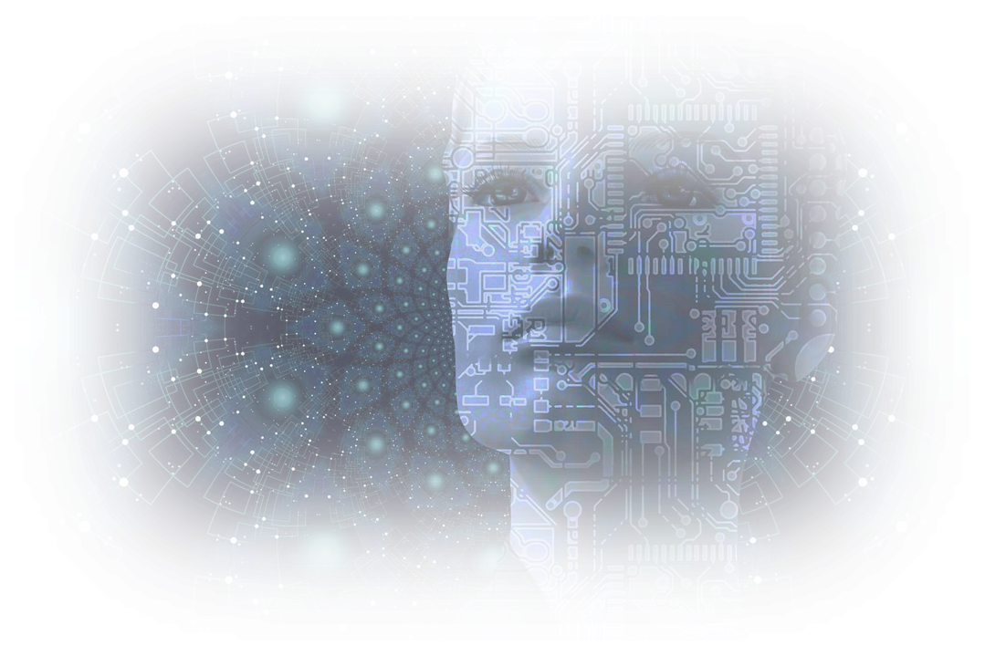
Agenda
PROBLEM STATEMENT
EXISITING SYSTEM
PROPOSED METHODOLOGY
IMPLEMENTATION

Slide 3
PROBLEM STATEMENT
Next-Gen Home Security Framework with Facial Recognition and IoT Integration
ABSTRACT
In the modern age of technology, enhancing home security systems has become imperative. This paper presents a novel approach to smart home security by integrating facial recognition, Internet of Things (IoT), and a web interface into a unified system. The proposed system leverages machine learning algorithms for accurate and real-time facial recognition to control access to a home. Upon successful recognition, an IoT-enabled servo motor is activated to unlock the door. A web interface developed using Flask allows users to monitor and control the system remotely, providing added flexibility and convenience. The system is designed to offer a robust, efficient, and user-friendly solution to home security, addressing limitations in existing models. The implementation is discussed in detail, showcasing the advantages and potential modifications to further enhance the system's performance.

Slide 4
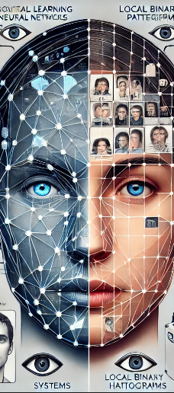
EXISTING SYSTEM
Existing facial recognition systems, such as those using deep learning models like Convolutional Neural Networks (CNNs), offer higher accuracy and better generalization capabilities compared to LBPH (Local Binary Patterns Histograms). CNN-based models, particularly with large datasets, can detect and recognize faces across diverse conditions, such as different lighting, angles, and facial expressions. However, these systems often require more computational power and extensive training, making them less suitable for lightweight or resource-constrained environments like the Raspberry Pi used in this project. In contrast, LBPH, while simpler and less computationally demanding, is effective for small-scale applications and works reasonably well with lower-resolution images and smaller datasets. LBPH’s trade-offs include less robustness in challenging scenarios compared to CNNs but offer quicker deployment and reduced hardware requirements, making it more suitable for real-time applications with limited resources, as demonstrated in this smart home security system project.

Slide 5
PROPOSED METHODOLOGY

Slide 6
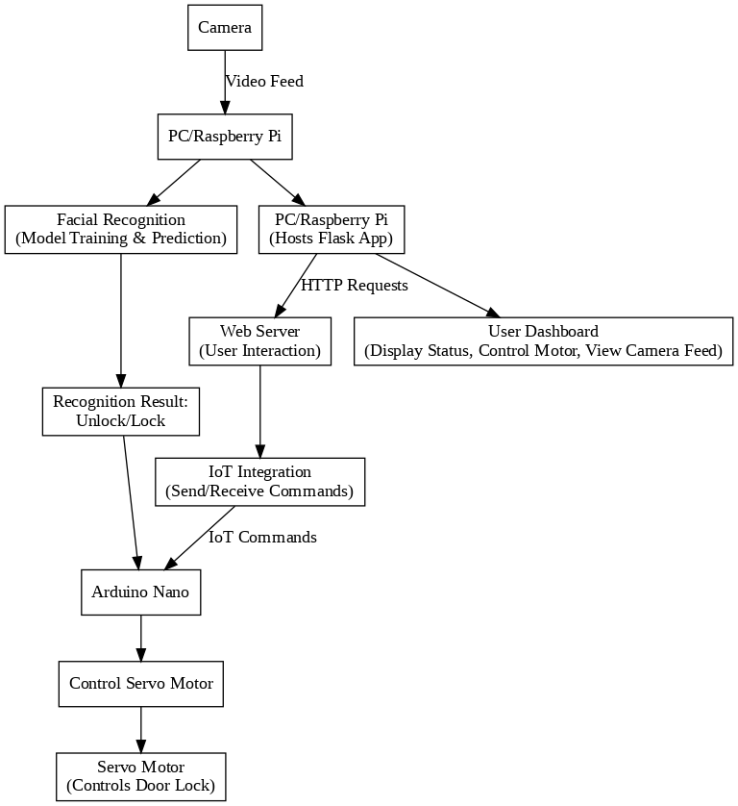
FLOW DIAGRAM

Slide 7
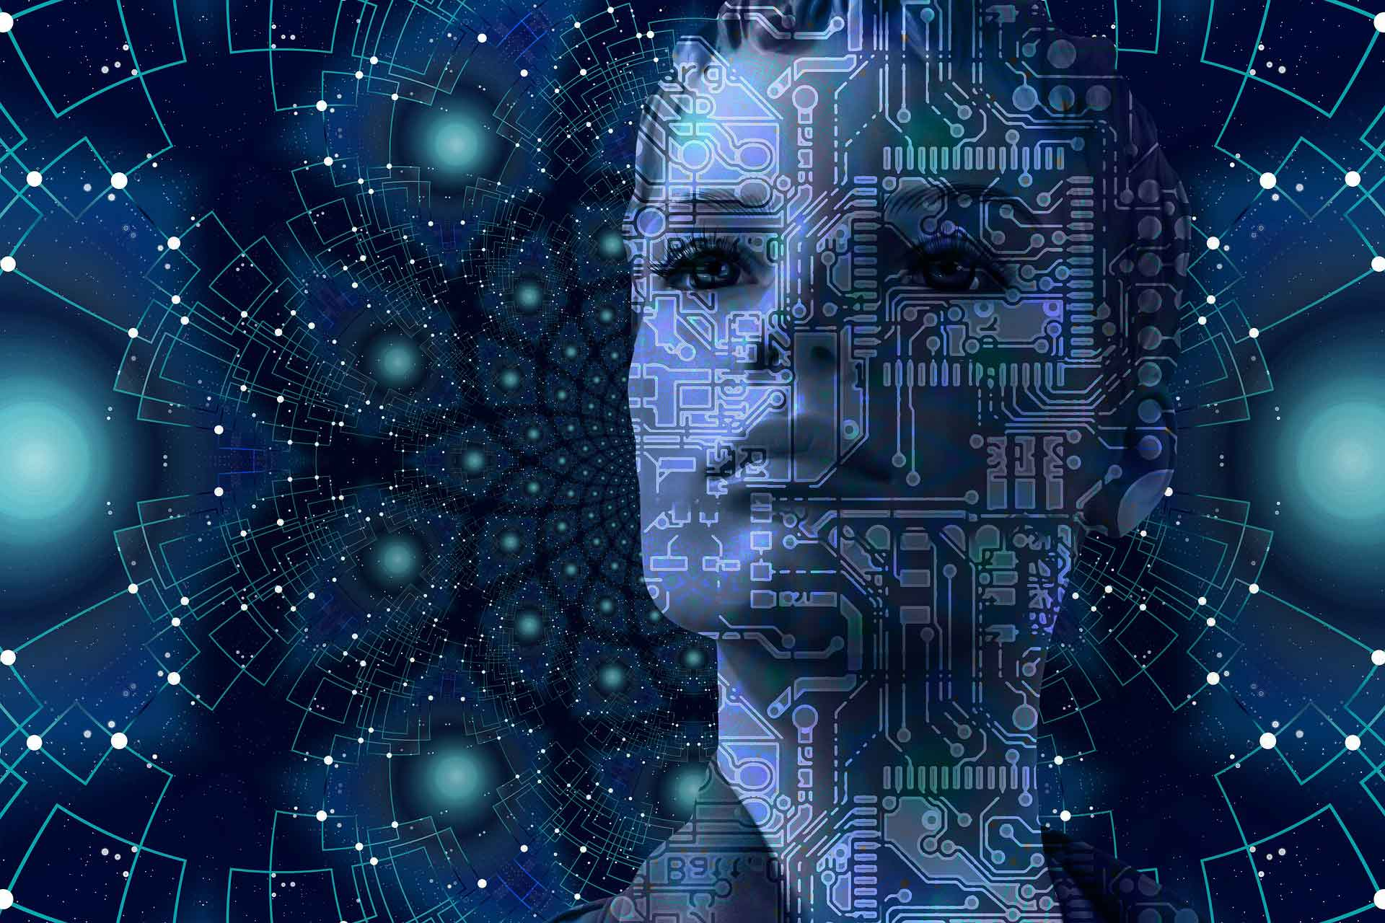
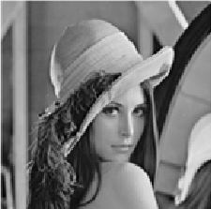
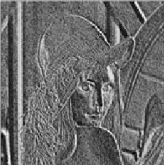
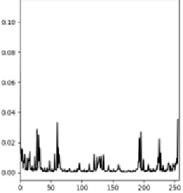
ALGORITHM USED
The system captures a live video feed from a camera positioned at the entrance. The captured frames are processed to detect faces using the Haar Cascade Classifier. Once a face is detected, it is cropped, converted to grayscale, and resized to match the input dimensions required by the facial recognition model. The LBPH algorithm then extracts features from the face, generating a histogram that represents the local patterns of the image. The generated histogram is compared with the stored templates of authorized faces. If the similarity score exceeds a predefined threshold, the system concludes that the face is recognized, and the individual is granted access.

Slide 8
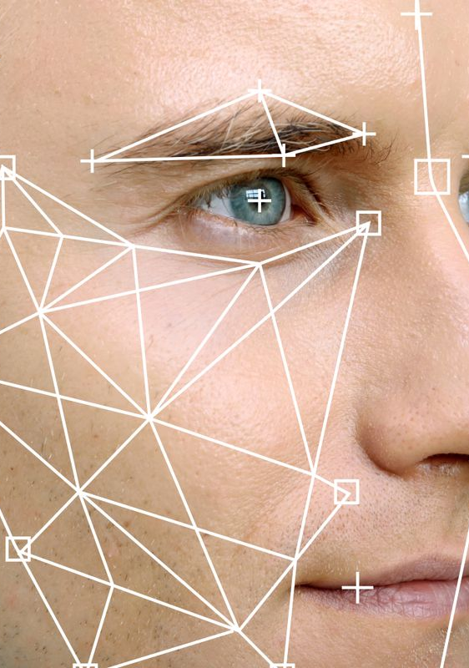
IMPLEMENTATION

Slide 9
Machine Learning for Facial Recognition
Recent advancements in biometric authentication have made significant strides, but challenges still remain. Many systems, such as those using multimodal biometrics or ECG-based methods, face obstacles like hardware limitations, complex data preparation, and the need for more advanced algorithms to enhance accuracy. Traditional biometric systems, including voice and facial recognition, also grapple with hardware constraints and environmental factors.
ALGORITHM WORKING
A camera at the entryway provides a live video feed that is captured by the system. The Haar Cascade Classifier is used to process the collected frames and identify faces. After a face is identified, it is shrunk, cropped, and grayscaled to fit the input dimensions needed by the facial recognition algorithm. After that, the LBPH algorithm extracts the face's features and creates a histogram that shows the image's local patterns. The authorised face templates that are stored are compared to the histogram that was generated. The system determines that the face is recognised if the similarity score is more than a predetermined threshold, at which point the user is given access.

Slide 10
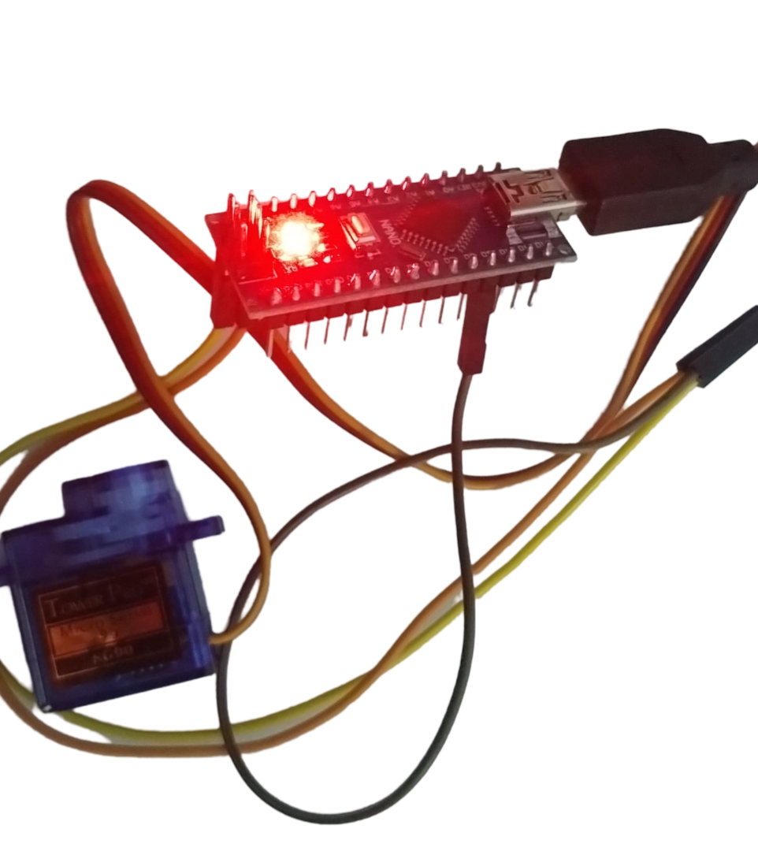
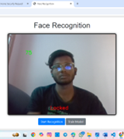
IOT INTEGRATION
When facial recognition is successful, the system instructs an Arduino Nano microcontroller to turn on a servo motor that is attached to the door lock. The door may be automatically unlocked without the user having to physically interact with it thanks to its IoT integration. Additionally, the microcontroller can be set up to close the door in response to a remote command or after a predetermined amount of time.
WEB INTERFACE
A Flask-based web application serves as the user interface, allowing homeowners to monitor and control the system remotely. The web interface provides real-time updates on the system status, including whether the door is locked or unlocked and if any unauthorized access attempts have been made. Users can also manually control the door lock and view the live camera feed through the interface, providing an additional layer of convenience and security.

Slide 11
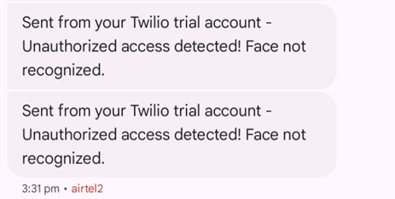
TWILIGHT API
To improve the user experience, a new feature that incorporates smartphone notifications has been included to the proposed system. The system is intended to deliver real-time SMS notifications straight to a user's mobile device using the Twilight API. With this integration, consumers are guaranteed to be notified as soon as important events occur, such successful facial recognition or security breaches. Twilight is a feature-rich messaging service that facilitates easy text message transmission using an easy-to-use API call. When a face is not identified or recognised by the facial recognition system, or when the system unlocks the door, users will especially benefit from this feature. By integrating smartphone notifications, the system raises user engagement and security while simultaneously improving accessibility by instantly updating and alerting users to their mobile device.

